Slide 1
Program
MineOperate Technical Overview
GPS Overview
Edgar Sepulveda
Global Technical Manager, MineOperate
Date 10/10/2022
Version 1.3

Slide 2

Purpose
This session shows GPS fundamentals.
At the end of this module, you will:
understand how GNSS works.
know what is needed to get navigation locations.
know GPS differences between LP and HP equipment.

Slide 3
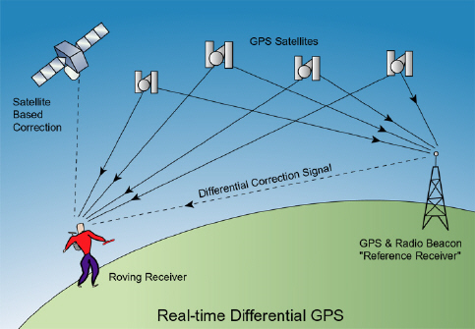
GPS Fundamentals
The Global Navigation Satellite System (GNSS) also known as the Global Positioning System (GPS)
Navigation system provide location and time information in all weather conditions, anywhere on or near the earth’s surface where there is an unobstructed line of sight to four or more satellites
Satellites > Base Station > GPS receiver
GPS uses the fixed ground base reference station to broadcast the difference between the positions indicated by the satellite and the known fixed locations.

Slide 4

GPS Location Video Demo
Notes:
High-precision machine control allows shovels, dozers, drills and draglines to carry out a plan to the highest levels of accuracy.
The need for staking is eliminated; site plans are downloaded directly to the cabin, which can then be carried out to within an accuracy of 15 centimetres.
Two satellite receivers are used and to achieve this level of accuracy, eight or more satellites are required for this footprint.

Slide 5
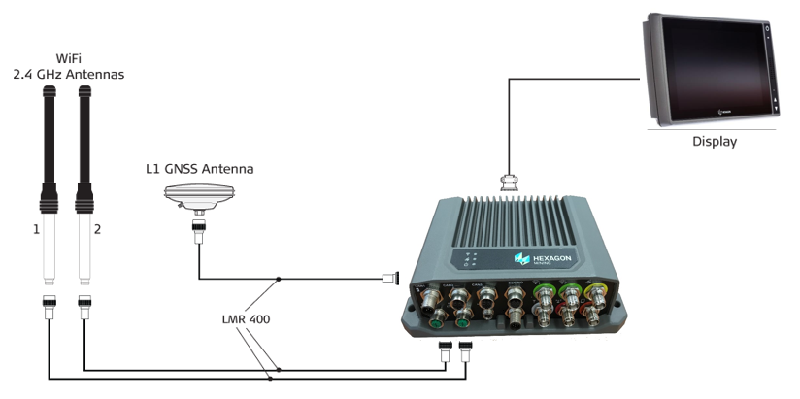
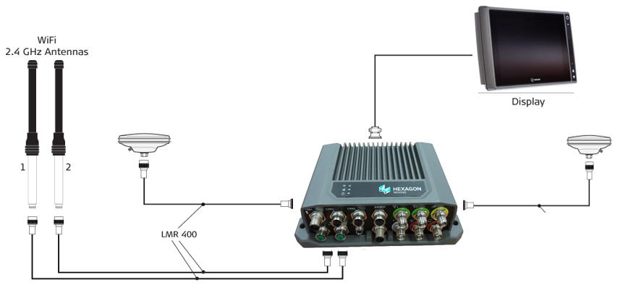
Additional GNSS Constellations
Core LP
The CoreLP box uBlox m8 GNSS receiver allow 3 constellations:
GPS
GLONASS
GALILEO
Core HP
The CoreHP box OEM719 Novatel cards allow 4 constellations:
GPS
GLONASS
GALILEO
BEIDOU
Notes:
Current Satellite Coverage - 48 satellites
New Satellite Coverage - 105 satellites
=> 120% Increase!
Position will configure the OEM719 to use NMEA version 4.1

Slide 6
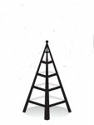
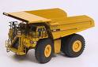
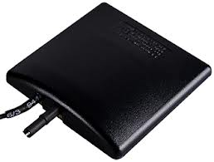
Low Precision Equipment
GPS Satellites
WLAN
Equipment
OEM sensors
1 x GPS Antenna with the Core LP receiving 4 or more satellites
Accuracy = ±15m
Ensures equipment is in the right place at the right time
Notes:
High-precision machine control allows shovels, dozers, drills and draglines to carry out a plan to the highest levels of accuracy.
The need for staking is eliminated; site plans are downloaded directly to the cabin, which can then be carried out to within an accuracy of 10 centimetres.
Two satellite receivers are used and to achieve this level of accuracy, eight or more satellites are required for this footprint.
RED UHP

Slide 7
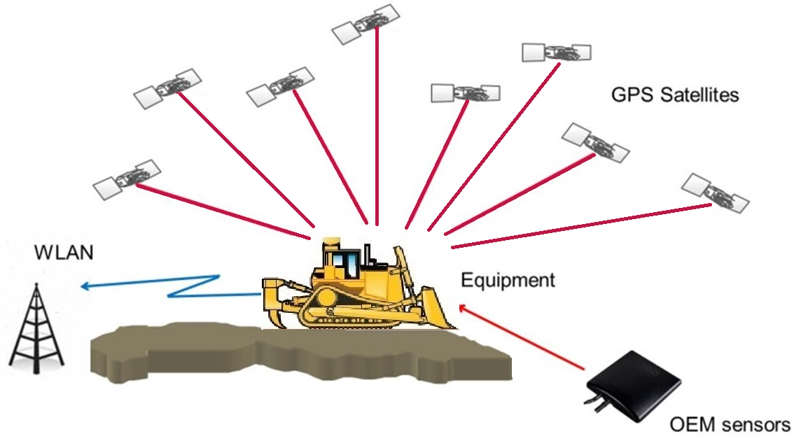
High Precision Equipment
Precision: 150mm
Moving material with high precision (drills, shovels, dozers)
Dual GPS receivers in the Core HP (dual GPS antennas)
A correction signal from a site base-station
Sensors fitted to the equipment to determine the geometry of the machine

Slide 8
Summary of LP /HP Equipment
 | Low Precision | High PrecisionHP
Used for | Equipment is in the right place at the right time | Moving materials with high precision (drills), shovel, dozers
Precision/Accuracy | +/- 15 m | +/- 150mm
GPS antennas | 1 | 2
Sensors | VIMS – load Speed Gear | Boom /Bucket /Stick (shovel) Chassis/Mast (drill) Chassis/Blade (dozer)

Slide 9

Dilution of Precision (DOP)
Need at least 4 satellites AND good DOP (Dilution of Precision) to solve for X, Y, Z and TIME
Good (Low) DOP
Good Positioning
Poor (High) DOP
Poor Positioning
Notes:
Bad DOP means BAD positioning, lack of satellites increases the DOP which is why lack of satellites turns into BAD positioning.
More satellites can help, but still need good DOP (angles).

Slide 10

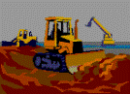
The Problem with GNSS Positioning
Satellite masking = Degraded or no RTK positioning
Satellite masking in deep pits or by high-walls.

Slide 11
GPS Concepts - Questions
True or False Navigation system provide location and time information in all weather conditions where there is an unobstructed line of sight to four or more satellites.
True or False GPS uses the fixed ground base reference station to broadcast the difference between the positions indicated by the satellite and the known fixed locations.
True or False Core LP allows 4 constellations.
True or False Core HP accuracy is 150 mm.
True or False Core HP is used on shovels, drills and dozers.

Slide 12
GPS Concepts - Answers to Questions
True or False Navigation system provide location and time information in all weather conditions where there is an unobstructed line of sight to four or more satellites. True
True or False GPS uses the fixed ground base reference station to broadcast the difference between the positions indicated by the satellite and the known fixed locations. True
True or False Core LP allows 4 constellations. False
True or False Core HP accuracy is around 150 mm. True
True or False Core HP is used on shovels, drills and dozers. True

Slide 13

THANK
Y
O
U

